Slide 1
Kafka connect

Slide 2
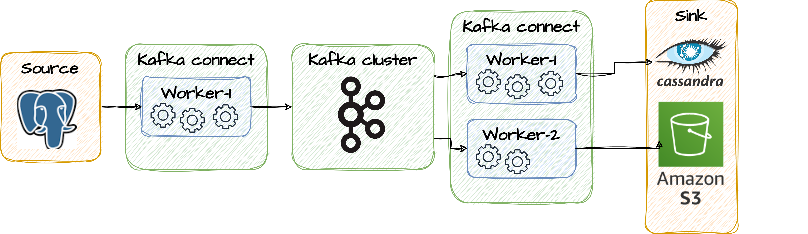
What is Kafka Connect
Kafka Connect is for building scalable and reliable data integration pipelines between Apache Kafka and external data systems. It's part of the Apache Kafka project and is designed to simplify the process of ingesting data into Kafka and exporting data from Kafka to various data sources.
Connectors + Tasks: Kafka Connect uses connectors and tasks to interact with various data sources and sinks. Connectors are available for a wide range of databases, storage systems, and other data platforms. These connectors make it easy to configure and manage the data flow.
Configurability: Kafka Connect is highly configurable. You can define and customize the data pipeline through configuration files without the need for writing code.
Built-in Converters: Kafka Connect provides built-in converters for data serialization and deserialization. It supports various data formats like Avro, JSON, and more.

Slide 3
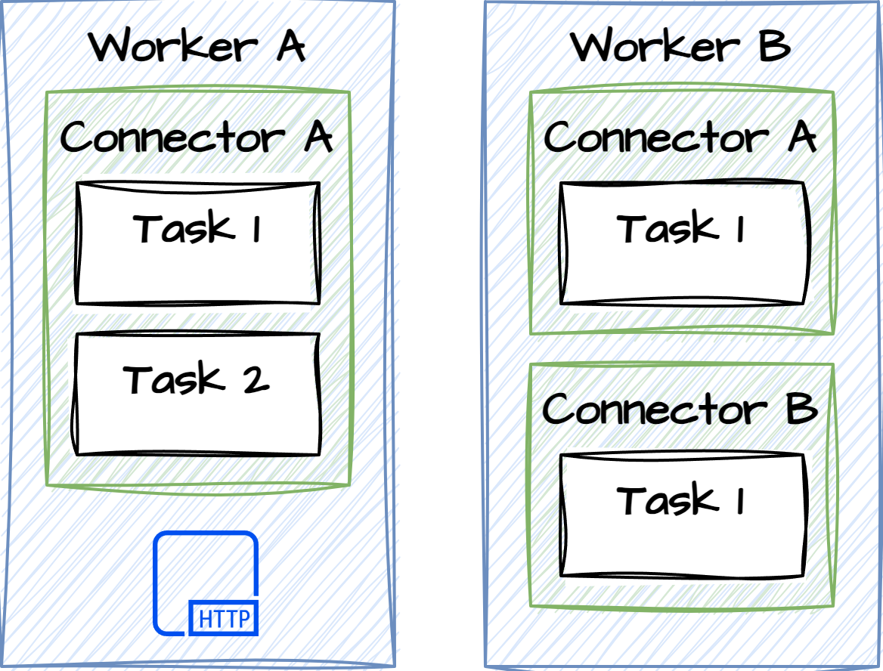
Connectors & Tasks
Connectors are responsible for creating configurations for a set of Tasks that split up the data processing. Second, they are responsible for monitoring inputs for changes that require reconfiguration and notifying the Kafka Connect runtime via the ConnectorContext. Kafka Connect will then request new configurations and update the running Tasks. Connectors can be configured during startup of Connect or at runtime by uploading a config file.
Interact with Worker
https://docs.confluent.io/platform/current/connect/kafka_connectors.html
public abstract class Connector implements Versioned {
public abstract void start(Map<String, String> props);
public abstract Class<? extends Task> taskClass();
public abstract List<Map<String, String>> taskConfigs(int maxTasks);
public abstract void stop();
public abstract ConfigDef config();
}
public interface Task {
String version();
void start(Map<String, String> props);
void stop();
}
Task Impl of the connector
Specified in properties

Slide 4
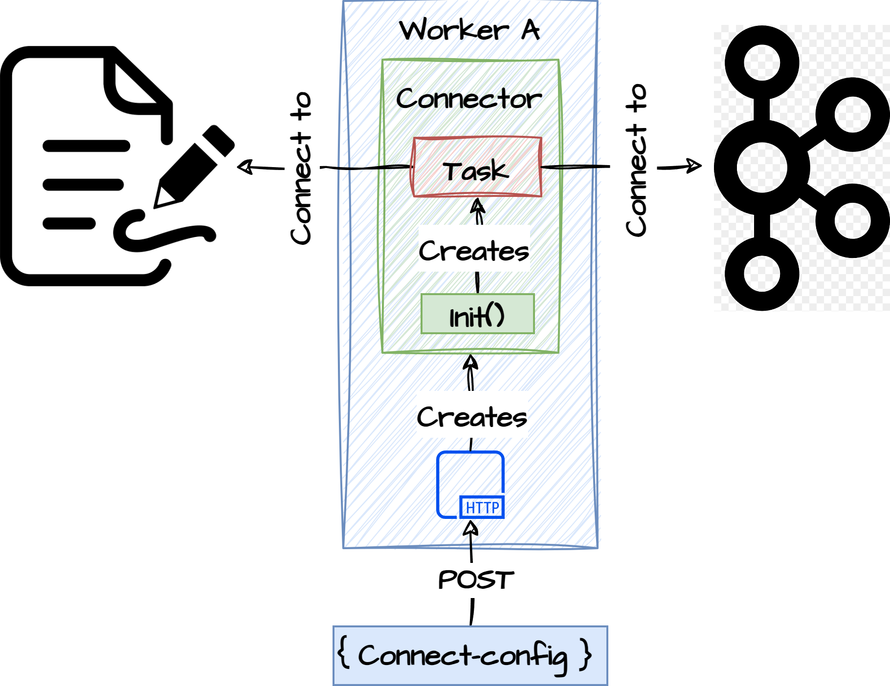
How to configure connect
{
"name": "input-file-source",
"config": {
"connector.class":"org.apache.kafka.connect.file.FileStreamSourceConnector",
"tasks.max":"1",
"topic":"input-file-data",
"file": "/tmp/input.txt"
}
}

Slide 5
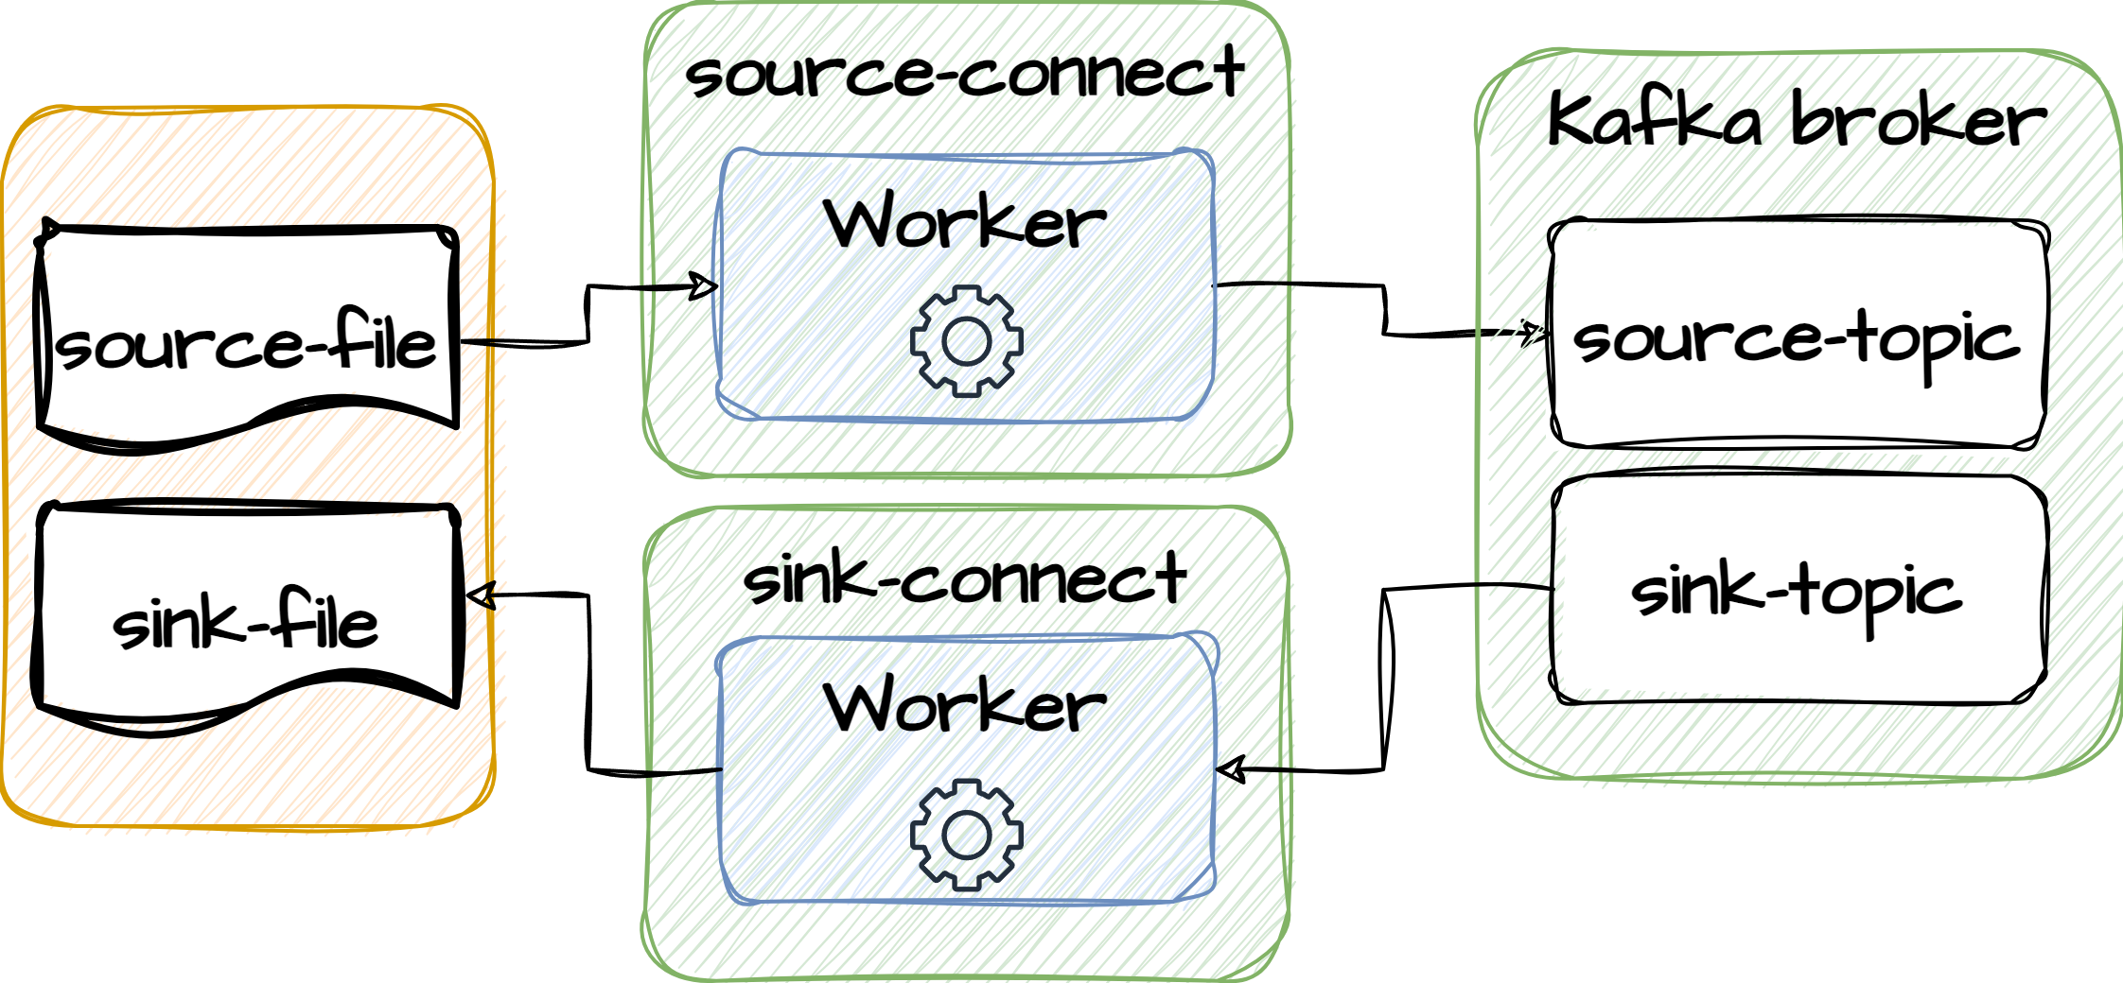
Exercise
Walk through of how the file connectors are configured
Connect docker container, boot properties
Mapped volumne
file-source-config.json
file-sink-config.json
9.1

Slide 6
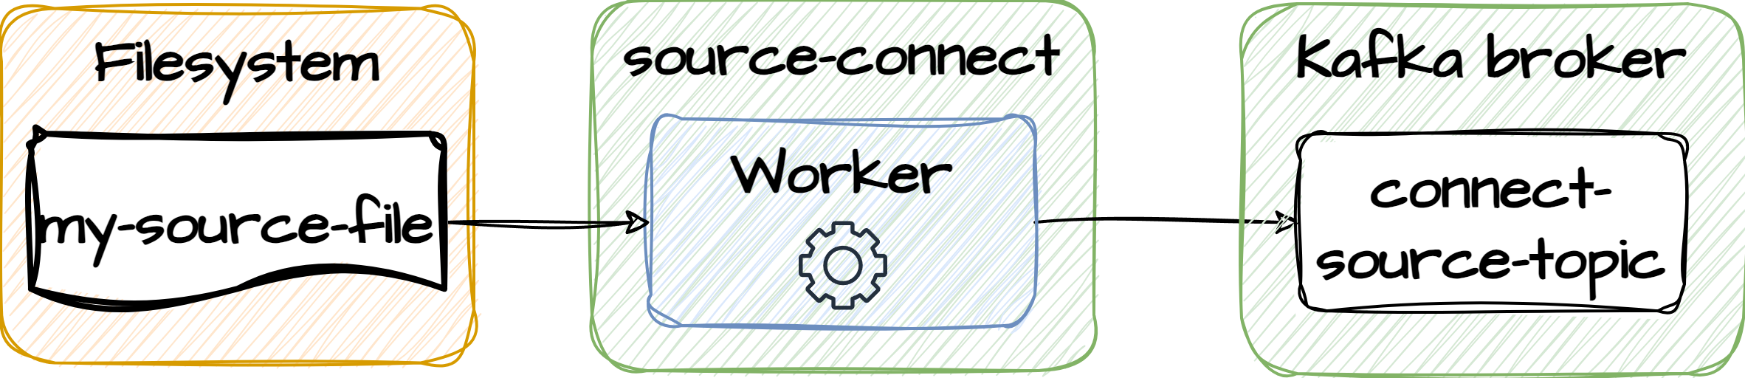
Exercise
9.2
Run a Kafka connector that reads from a file and writes to a topic
In powershell navigate to <project-folder>/docker/kafka-connect.
Type Invoke-WebRequest -Uri http://localhost:8083/connectors/ -Method POST -ContentType application/json -InFile .\file-source-config.json
Start a consumer that consumes from the topic specified for the connector properties file
Open the file that Kafka connect if configured to read from
Type some lines of text and save the file
See that the lines you just typed are reflected in the topic

Slide 7
Exercise
Inspect the file connectors using the build in API
Open a browser and type http://localhost:8083/connectors
You should see the two connectors that have been configured
Open a new tab and type http://localhost:8083/connectors/{connector-name}
You should see how the connector is configured
Open a new tab and type http://localhost:8083/connectors/file-source-connector/status
You should see runtime information about the connector
9.3

Slide 8
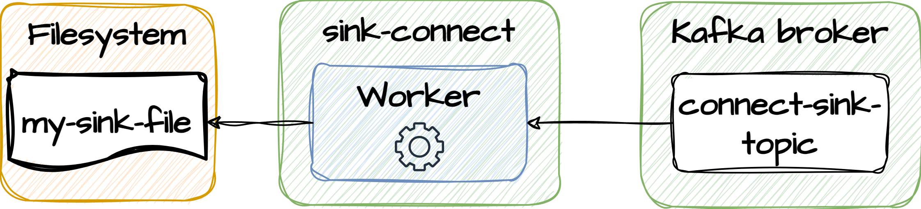
Exercise
9.4
Run a Kafka connector that reads from a topic and writes to a file
In powershell navigate to <project-folder>/docker/kafka-connect.
Type Invoke-WebRequest -Uri http://localhost:8083/connectors/ -Method POST -ContentType application/json -InFile .\file-sink-config.json
Start a consumer that consumer from the topic specified for the connector properties file
Write some messages to the topic
Open the file that Kafka connect if configured to write to as see that the messages are there

Slide 9
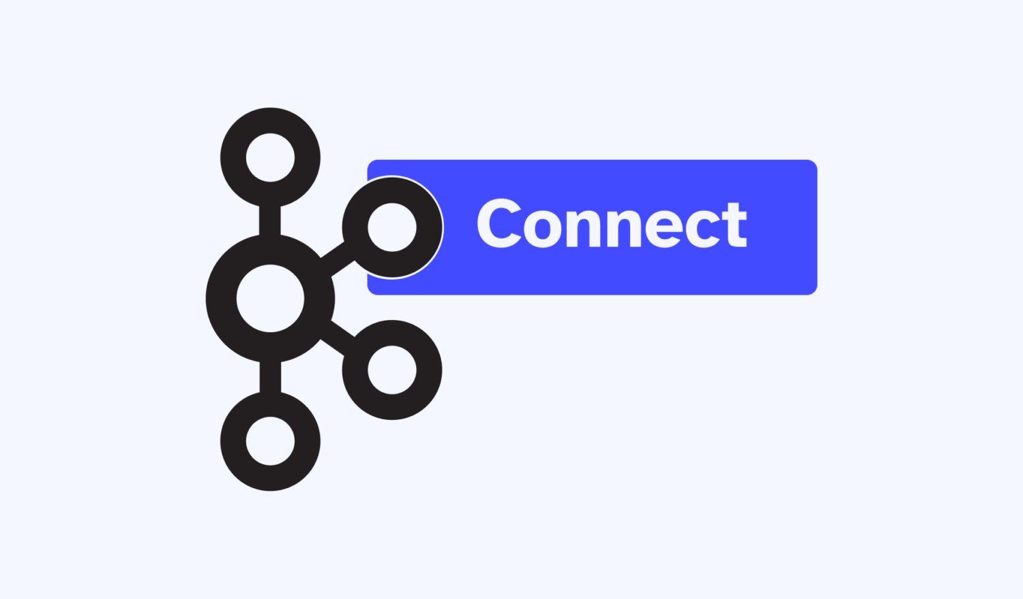
Exercise
Build a Kafka Streams application that reads from one topic to the other
Create a Kafka Streams application that reads from the input-file-data topic, does some String transformation (eg reverse or upperCase) to the message and writes it to the output-file-data topic
Start the application
Open the input.txt and type some lines of text. Save file and see if the transformed lines show up in output.txt
9.5

Slide 10
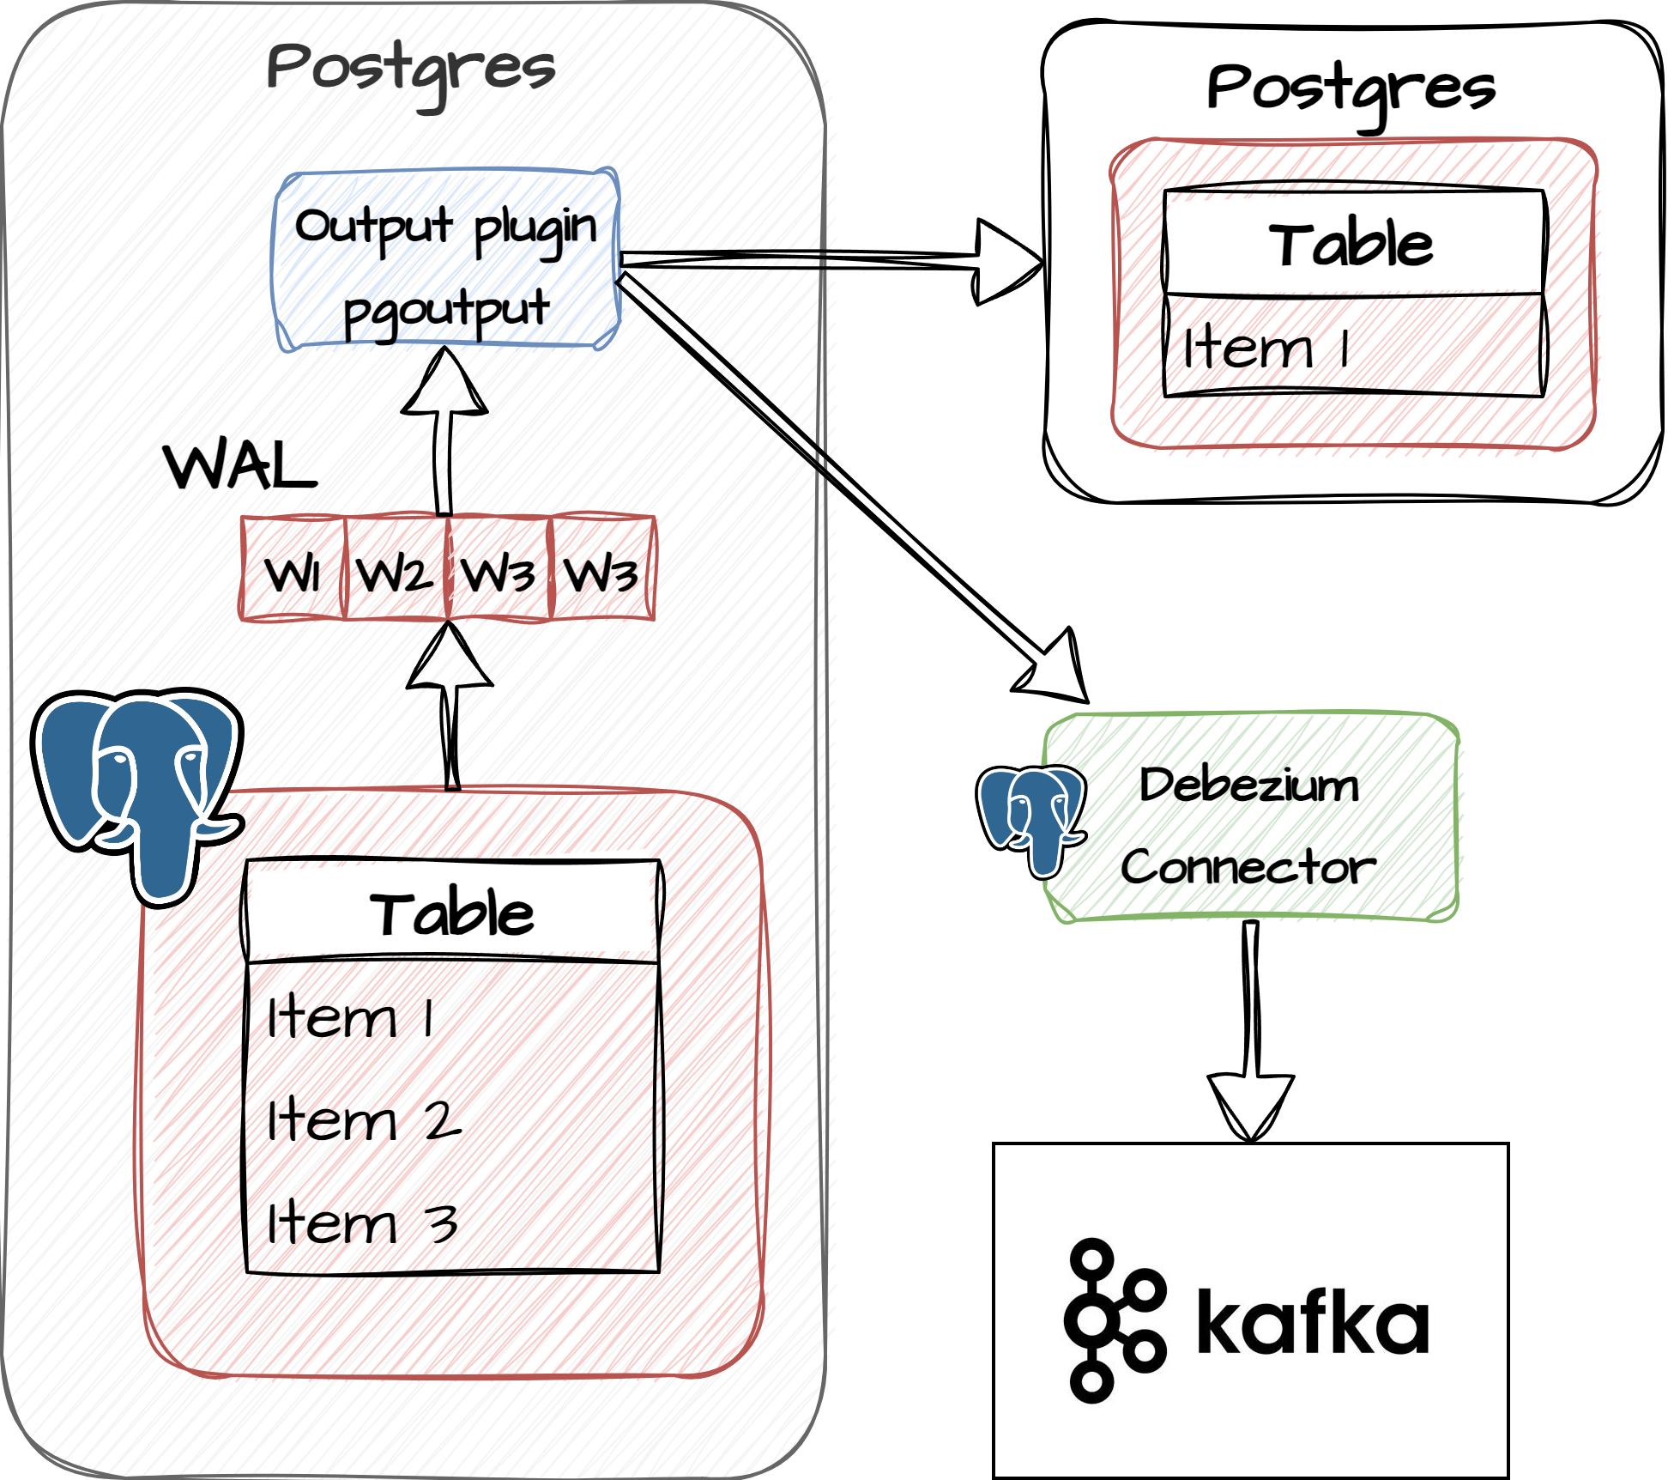
Postgres debezium
Replicate to cluster members
Translation from binary format
Piggybag on replication protocol
Use outbox table pattern

Slide 11
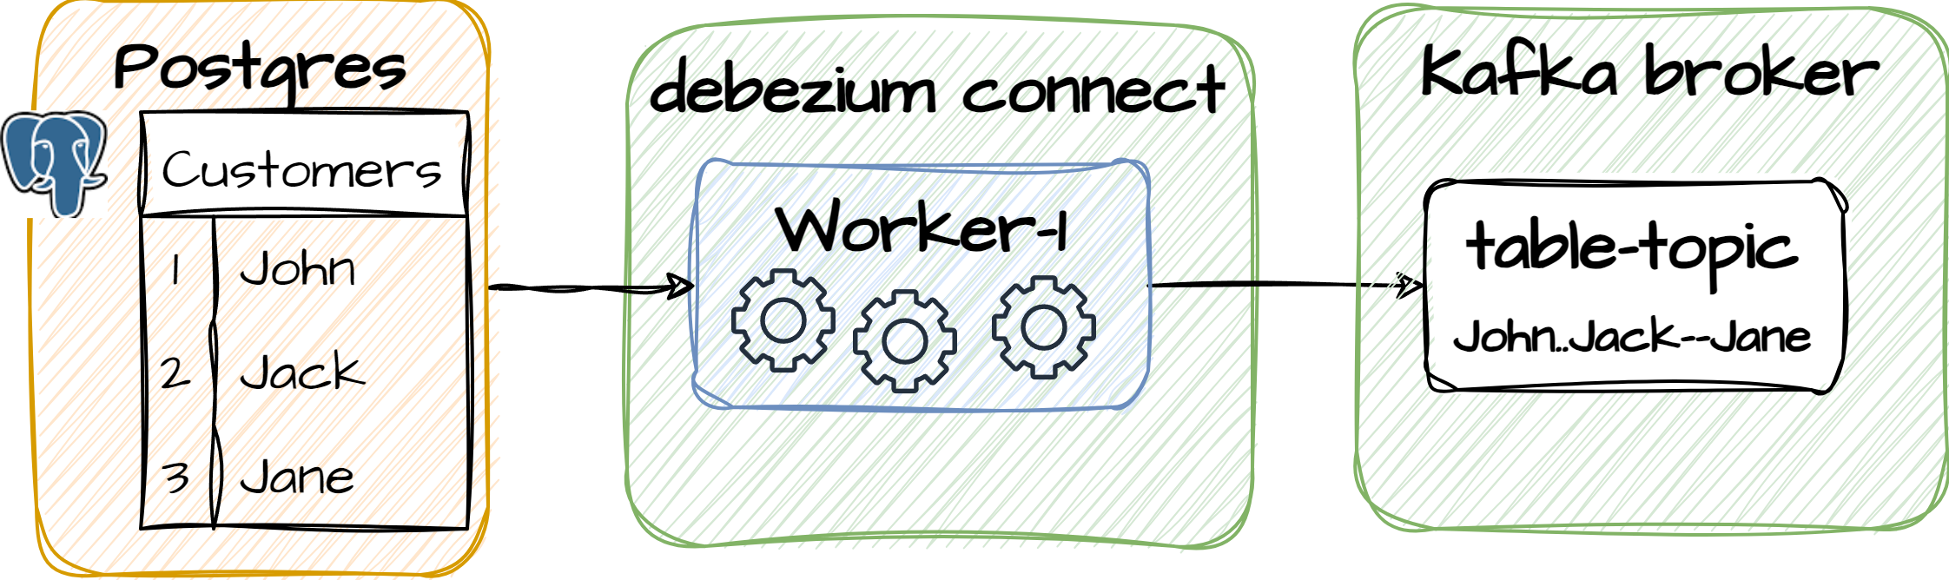
Exercise
Walk through of how the CDC connector is configured
Docker compose file: postgres and postgres-connect
pg-source-config.json
9.6
{
"name": "pg-orders-source",
"config": {
"connector.class": "io.debezium.connector.postgresql.PostgresConnector",
"database.hostname": "postgres",
"database.port": "5432",
"database.user": "postgres",
"database.password": "postgres",
"database.dbname": "postgres",
"database.server.name": "myserver",
"plugin.name": "pgoutput",
"table.include.list": "public.customers",
"value.converter": "org.apache.kafka.connect.json.JsonConverter"
}
}

Slide 12
Exercise
Configure a Postgres CDC connector
Look at the Docker Compose file and find the two services: postgres and postgres-connector. Understand the setup!
Connect to Postgres. Open PowerShell and type docker exec -it postgres bash
Login to Postgres. Type psql -U postgres
Create db-table, type: CREATE TABLE customers (id int GENERATED ALWAYS AS IDENTITY PRIMARY KEY, name text);
Alter table, type: ALTER TABLE customers REPLICA IDENTITY USING INDEX customers_pkey;
Insert data, type: INSERT INTO customers (name) VALUES ('john'), ('jack'), ('jane');
Configure debezium-connector. Open PowerShell and navigate to <project-folder>/docker/kafka-connect.
Open a browser and type https://localhost:9090 to confirm the connector is running
In powershell, type Invoke-WebRequest -Uri http://localhost:8083/connectors/ -Method POST -ContentType application/json -InFile .\pg-source-config.json
Open akhq.io on http://localhost:8080/ to see that a new topic has been created and populated
9.7

Slide 13
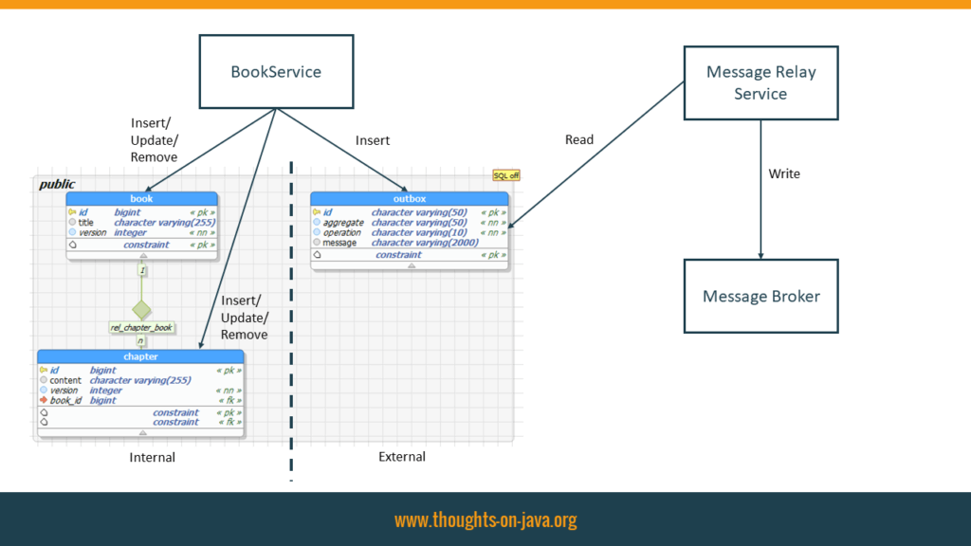
Debezium transformations
Transform | Description
Topic Routing | Re-routes records to different topics based on a regular expression applied to the original topic name.
Content-Based Routing | Reroute selected events to other topics, based on the event content.
New Record State Extraction | Extracts the flat structure of field names and values from Debezium change events, facilitating sink connectors which cannot process Debezium’s complex event structure.
MongoDB New Document State Extraction | The MongoDB-specific counter-part to the New Record State Extraction SMT.
Outbox Event Router | Provides a way to safely and reliably exchange data between multiple (micro) services.
MongoDB Outbox Event Router | The MongoDB-specific counter-part to the Outbox Event Router SMT.
Message Filtering | Applies a filter to the change events emitted by the connectors, based on their content. This lets you propagate only those records that are relevant to you.
Compute Partition | Re-routes records to specific partition based on configured table column.
HeaderToValue | Moves or copies headers into the record value.
Partition Routing | Re-routes records to specific partitions based on configured payload fields.
Timezone Converter | Converts Debezium and Kafka Connect timestamp fields in event records to a specified timezone.
TimescaleDB Integration | Routes and enriches messages that the Debezium PostgreSQL connector captures from a TimescaleDB.
Debezium Outbox SMT
{
"name": "pg-orders-source",
"config": {
"connector.class": "io.debezium.connector.postgresql.PostgresConnector",
"table.include.list": "public.customers-outbox“
...
"transforms"=outbox,... "transforms.outbox.type": "io.debezium.transforms.outbox.EventRouter" }
}
Notes:
"

